Slide 1
2023 CFC NMOC Poster Template
Every year, Federal employees like us at the [Dept/Agency Name] rally to support charities we choose through the CFC. It’s amazing to see how donating a little from each paycheck or pledging a few volunteer hours adds up to so much happiness when we give together.
And, studies show when you give happy, you get happy too!
GIVE HAPPY today at GiveCFC.org.

Slide 2
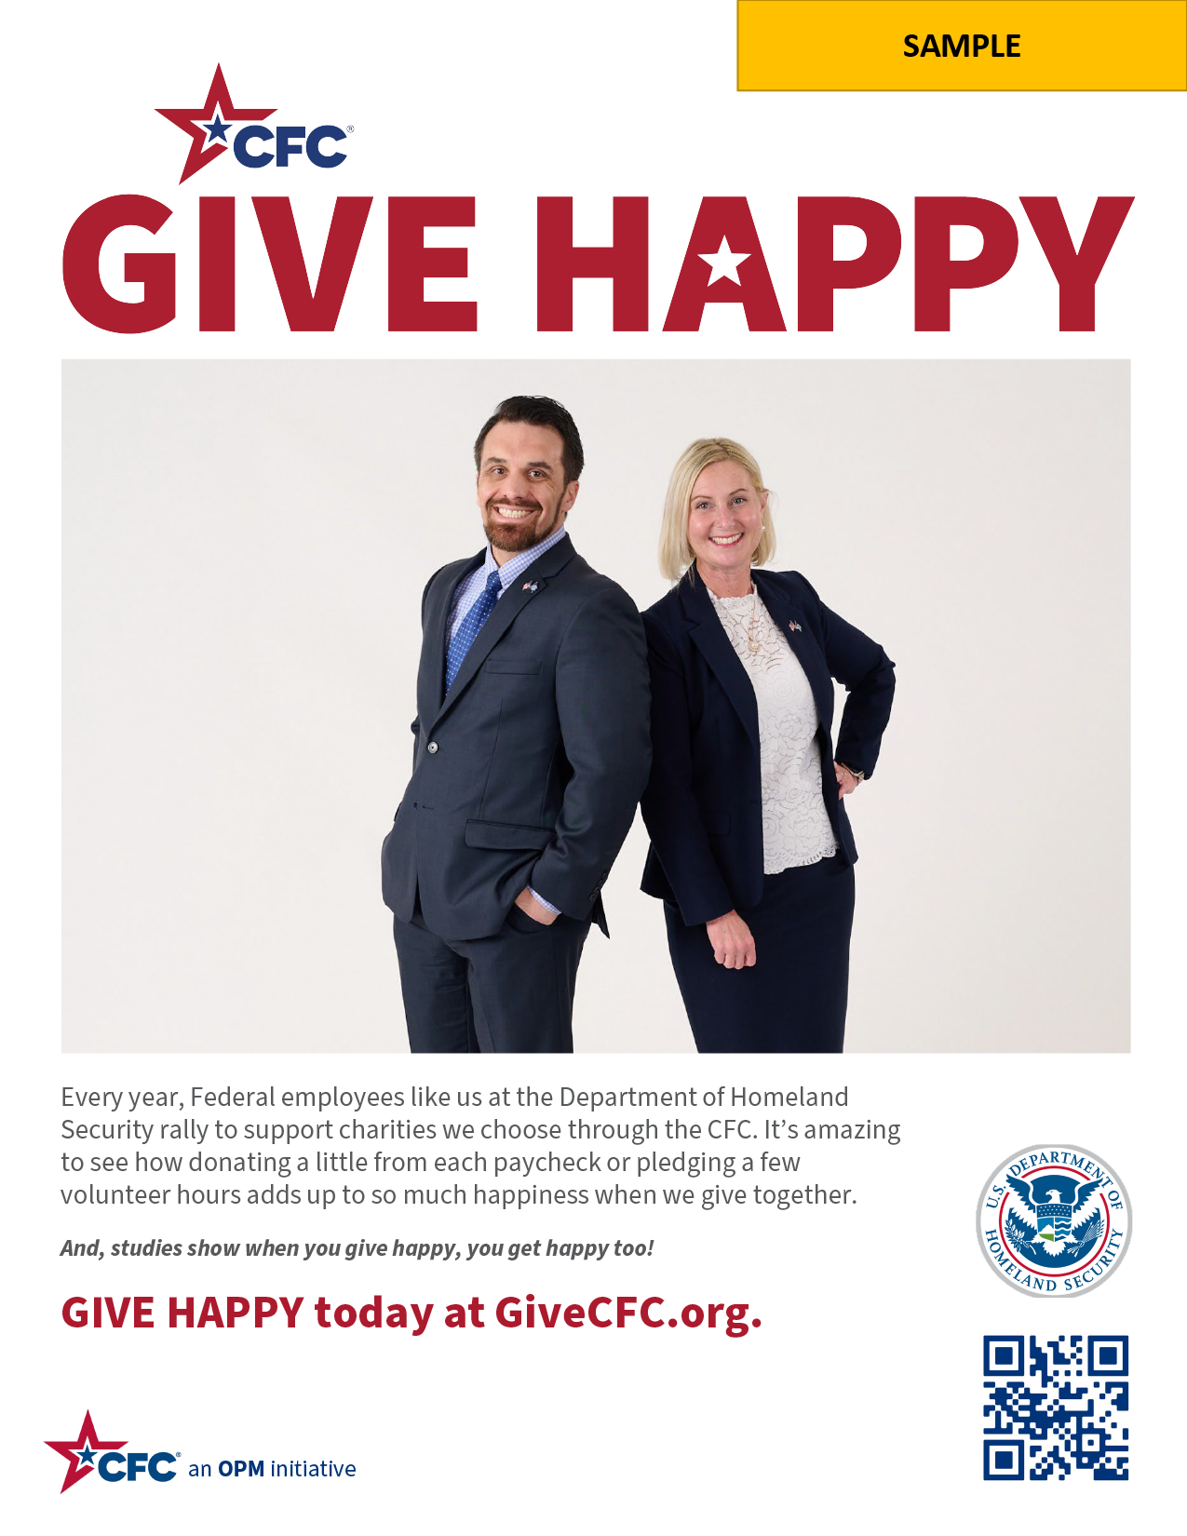

2023 CFC NMOC Poster Department Sample

Slide 3
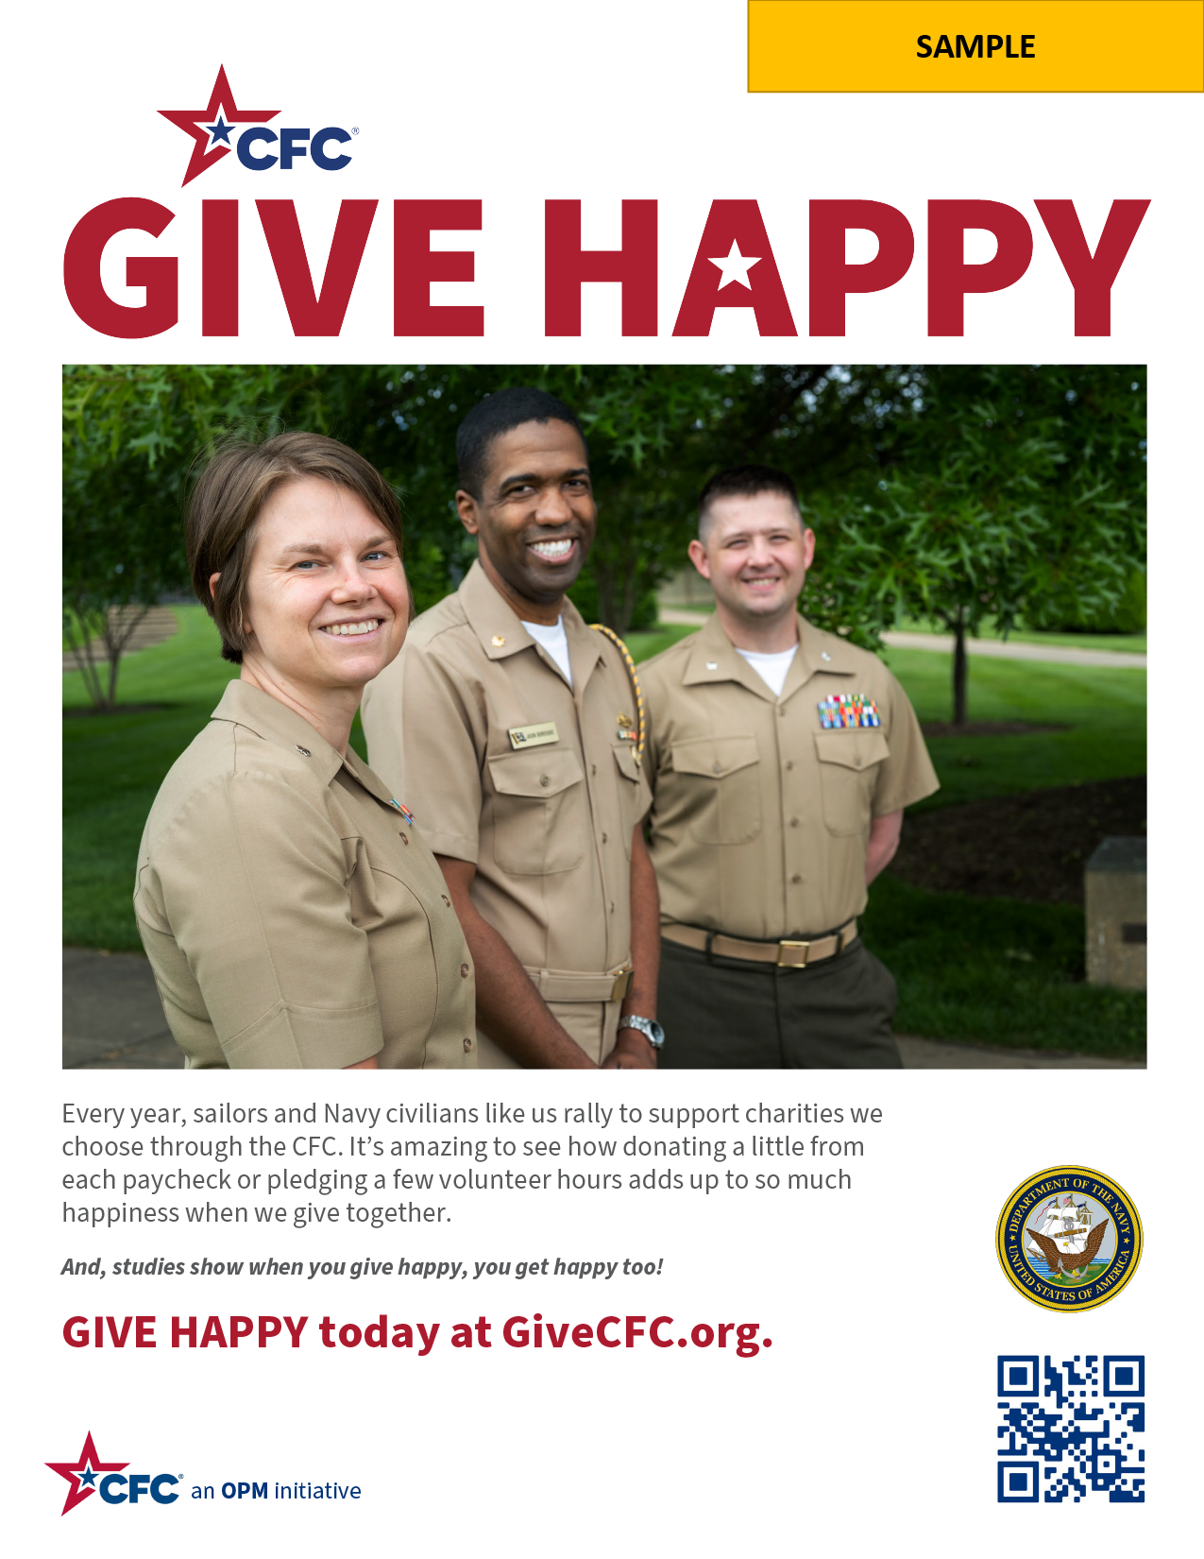
2023 CFC NMOC Poster Department Sample 2

